Slide 1
人工智慧專題
40611016E 學科110 張清華

Slide 2
應用目的
看是否能分類出病人是否有心臟病

Slide 3
資料來源 & 資料說明
https://www.kaggle.com/ronitf/heart-disease-uci
1. age
2. sex
3. chest pain type (4 values)
4. resting blood pressure
5. serum cholestoral in mg/dl
6. fasting blood sugar > 120 mg/dl
7. resting electrocardiographic results (values 0,1,2)
8. maximum heart rate achieved
9. exercise induced angina
10. oldpeak = ST depression induced by exercise relative to rest
11. the slope of the peak exercise ST segment
12. number of major vessels (0-3) colored by flourosopy
13. thal: 3 = normal; 6 = fixed defect; 7 = reversable defect

Slide 4
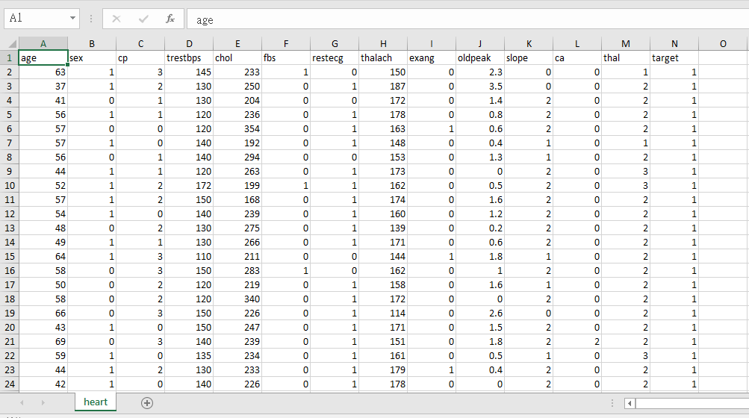
資料集

Slide 5
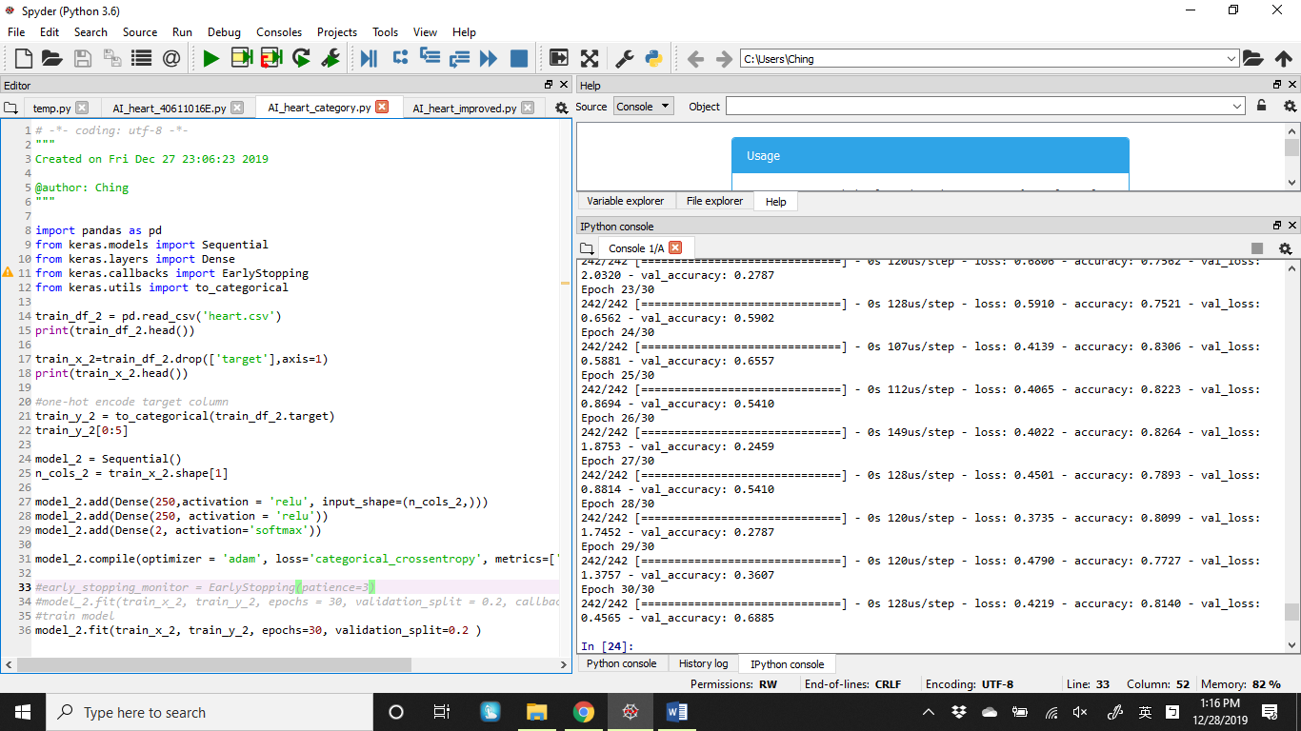
程式碼與準確度

Slide 6
程式碼與準確率
14-22 將要分類的目標(target)移除要分析的x_train_2，以及目標放入train_y_2
27-29 則是加入Dense
36 則是預測得到心臟病
loss: 0.4219 - accuracy: 0.8140 - val_loss: 0.4565 - val_accuracy: 0.6885

